Slide 1
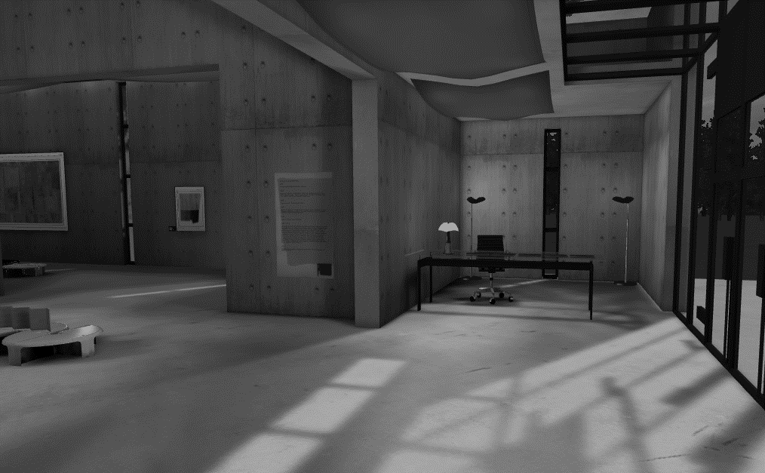


Creating 3D apps & games using Babylon.JS

Slide 2
David Catuhe
Windows Clients Evangelist Lead
http://aka.ms/david
@deltakosh
David Rousset
Windows Clients Evangelist
http://aka.ms/davrous
@davrous

Slide 3
Agenda
Why building a WebGL 3D engine ?
The old school way: Using the 2D canvas
The rise of GPUs
Using WebGL directly
Using Babylon.js to create 3D apps and games
How to use Babylon.js?
Advanced features
What we’ve learned…
Tracking and reducing the pressure on garbage collector
Performance first
Handling touch devices
Notes:
Davrous/davca/davrous

Slide 4
Why building a WebGL 3D engine ?
Notes:
Davrous – 4’’

Slide 5
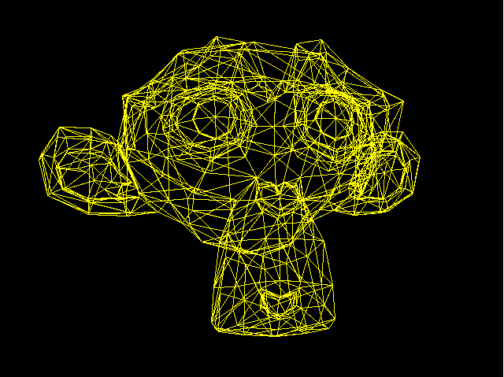
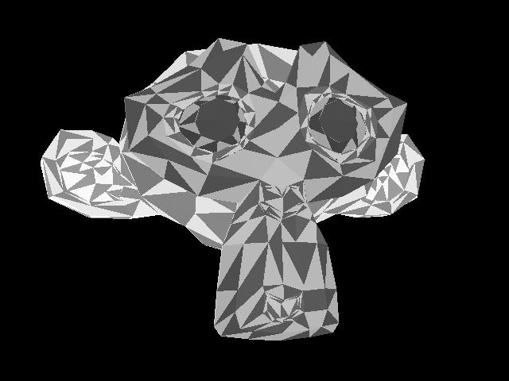


The oldschool way: using 2D canvas
Build a 3D “Software” engine that only uses the CPU
Wireframe
Rasterization
Lights & Shadows
Textures
Notes:
davrous

Slide 6
Soft Engine
DEMONSTRATION
Notes:
Davrous – 10’’

Slide 7
The rise of GPUs
Hardware accelerated rendering:
2D Canvas, CSS3 animations
Accelerated 3D
with WebGL
H264 & JPG hardware decoding
Notes:
davrous

Slide 8




Using WebGL directly
Requires a compatible browser:
A new context for the canvas:
canvas.getContext("webgl", { antialias: true}) || canvas.getContext("experimental-webgl", { antialias: true});
Notes:
davca

Slide 9

Using WebGL directly
WebGL is a low level API
Need to handle everything
except the rendering:
Shaders code (loading, compilation)
Geometry creation, topology, transfer
Shaders variables management
Texture and resources management
Render loop
Notes:
davca

Slide 10
WebGL 101
DEMONSTRATION
Notes:
Davca – 20’’

Slide 11
Using Babylon.js to create 3D apps & games

Slide 12
How to use Babylon.js ?
Open source project (Available on Github)
http://www.babylonjs.com
https://github.com/babylonjs/babylon.js
How to use it? Include one file and you’re ready to go!
To start Babylon.js, you’ve just need to create an engine object:
<script src="babylon.js"></script>
var engine = new BABYLON.Engine(canvas, true);

Slide 13
How to use Babylon.js ?
Babylon.js is a scene graph: All complex features are abstracted for YOU!
Handling rendering can be done in one line:
var scene = new BABYLON.Scene(engine);
var camera = new BABYLON.FreeCamera("Camera", new BABYLON.Vector3(0, 0, -10), scene);
var light0 = new BABYLON.PointLight("Omni0", new BABYLON.Vector3(0, 100, 100), scene);
var sphere = BABYLON.Mesh.createSphere("Sphere", 16, 3, scene);
engine.runRenderLoop(function() { scene.render(); });
Notes:
Davca -

Slide 14
Hello World with Babylon.js
DEMONSTRATION
Notes:
Davca – 25’’

Slide 15
Advanced features
Blender exporter
Design & render
Offline support IndexedDB
Complete collisions engine
Network optimizations Incremental loading
Notes:
davrous

Slide 16
Unleash babylon.js
DEMONSTRATION
Notes:
davrous– 35’’

Slide 17
What we’ve learned ?
Notes:
davca

Slide 18
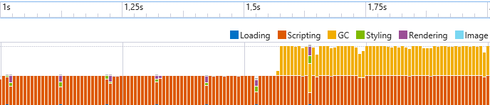
Tracking & reducing the pressure on GC
A 3D engine is a place where matrices, vectors and quaternions live.
And there may be tons of them!
Pressure is huge on the garbage collector

Slide 19
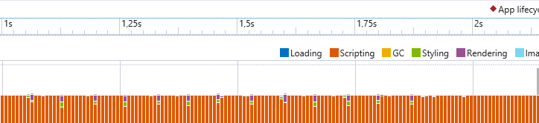
Tracking & reducing the pressure on GC
Maximum reuse of mathematical entities
Pre-instantiate
Stock variables
GC friendly arrays (able to reset size at no cost)
When the scene is up and running, aiming at no allocation at all

Slide 20
Using F12 to reduce memory pressure
DEMONSTRATION
Notes:
Davca – 40’’ (demo responsiveness / profiler)

Slide 21
Performance first
Efficient shaders
Do only what is REALLY required
Scene partitioning
Frustum / submeshes / octrees
Complete cache system
Update WebGL only when required
Notes:
Davca – 43’’

Slide 22









Handling touch devices
Notes:
Davrous- to the end (and beyond)

Slide 23
Hand.js and the TouchCamera
DEMONSTRATION

Slide 24
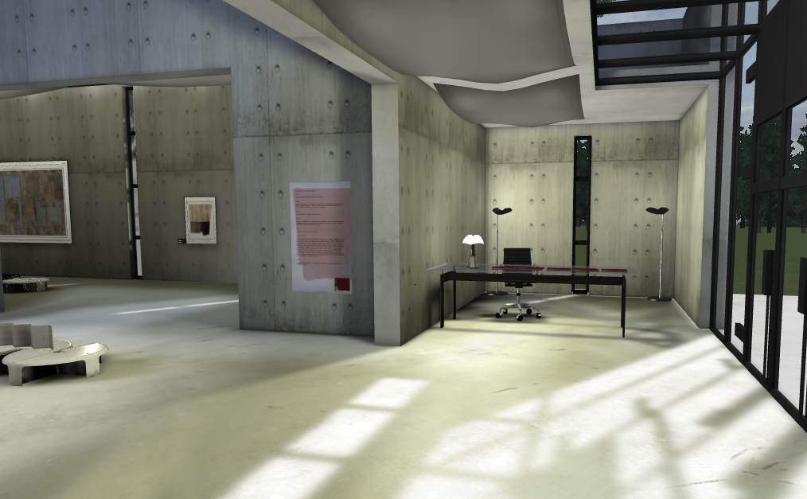
Questions ?
@deltakosh / @davrous

